Slide 1

Class Management System(GUI)
Ehsan ullah(46465)
Advanced Computer programming

Slide 2
Class Management System
A Class Management System (CMS) is a software application or system designed to efficiently manage and organize information related to students within an educational institution. This system is commonly used by schools, colleges, and other educational institutions.

Slide 3
Tools & Technologies
Programming Language: Java
GUI Framework: Java Swing
Database: MySQL
IDE: NetBeans IDE (Version 8.0.2)
Connector: MySQL Connector (Version 9.1.0)
Development Approach: Incremental Model
The System was developed in Increments and each module was built and tested after integrating into the system.

Slide 4
Functionalities
Login: Secure access with user credentials.
Data Insertion: Add new students or teachers into the system.
Data Display: View records in an organized table.
Data Print: Print Data of Teacher and Students.
Data Update: Edit existing records.
Data Deletion: Delete all records.
Fee Management: Track and manage fee submissions and dues.
Logout: Exit the system securely.

Slide 5
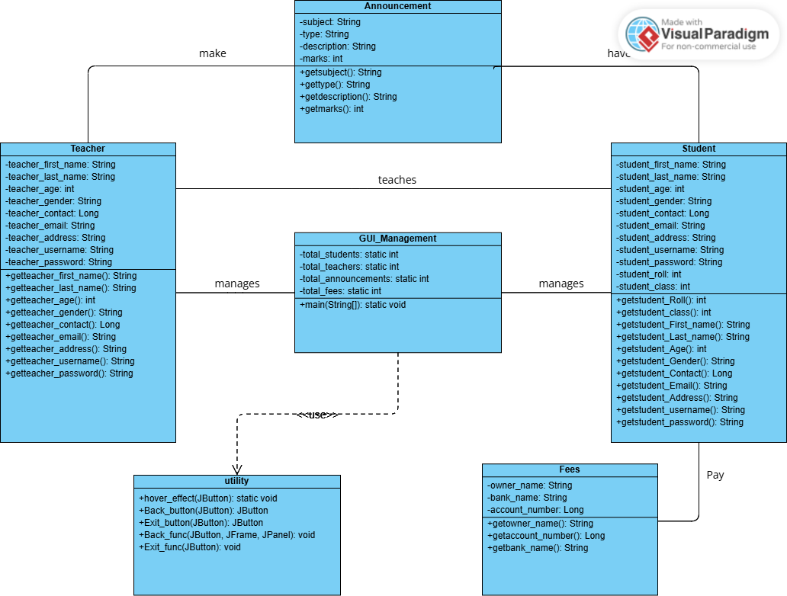
Class Diagram

Slide 6
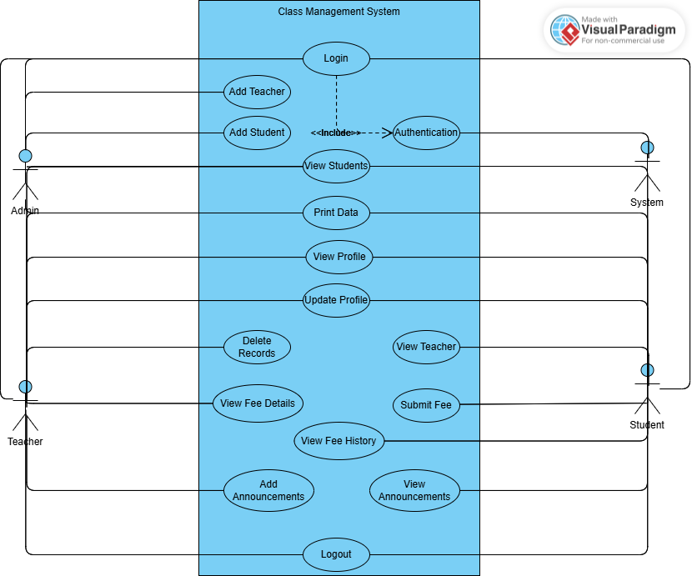
Use Case Diagram

Slide 7
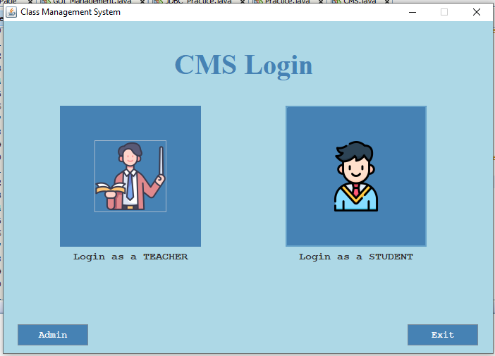
Interface

Slide 8
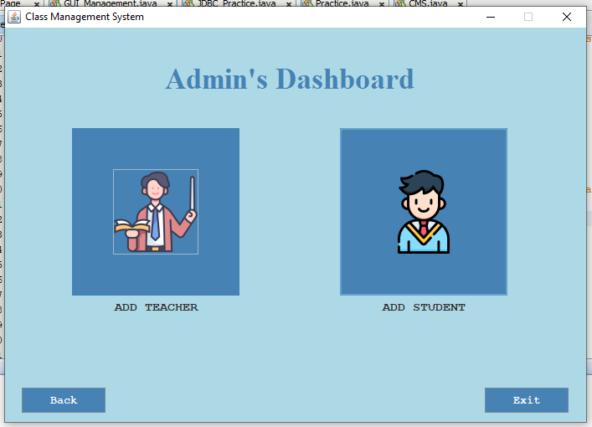
Admin Dashboard

Slide 9
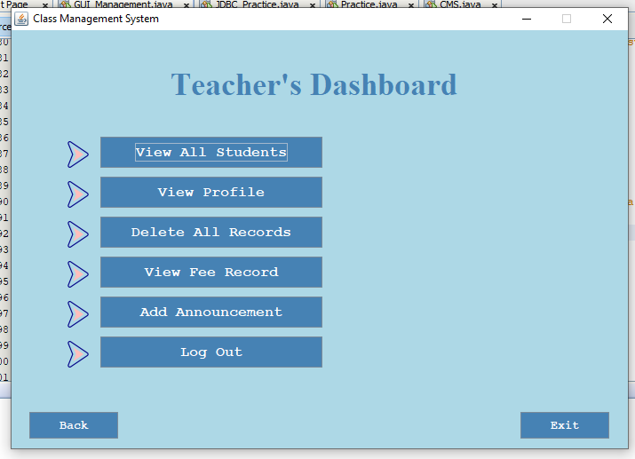
Teacher Dashboard

Slide 10
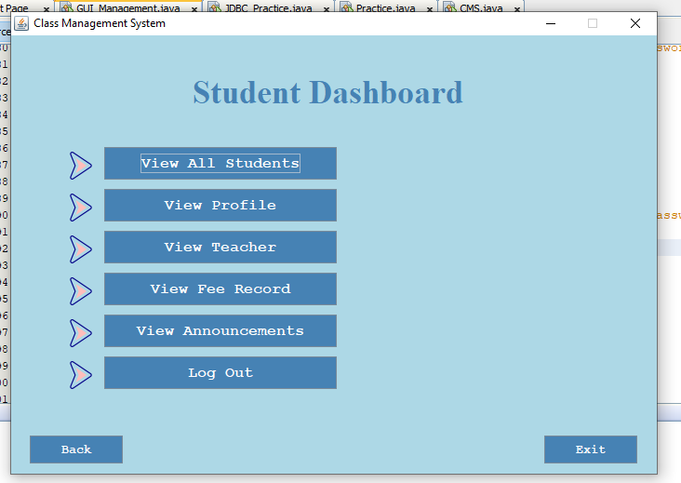
Student Dashboard

Slide 11
Key Features
Clean GUI with user-friendly interface.
Robust data handling (real-time updates).
Secure login and logout mechanism.
Printable data for record keeping.
Improved quality by testing each module in development.
Scalable for future enhancements.

Slide 12
Challenges & Solutions
Challenge 1: Repetitive Code Duplication.
Solution: Separate methods in Utility Class.
Challenge 2: Student Login Funtionality.
Solution: Using Loop and Break Statement and storing current student number in variable.
Challenge 2: Implementing fee management logic.
Solution: Designed a modular approach for fee tracking.

Slide 13
Database Connectivity
A database connection is established using JDBC.
Successfully stores both Teacher and Student data in the database.
Updates in the program automatically reflect in the database, maintaining real-time synchronization.
Implements error handling for database operations, such as connection failures or invalid queries using try catch blocks.

Slide 14
Testing
The system has been thoroughly tested for errors.
Each module is tested several times during development.
All critical areas of code are controlled by try catch blocks.

Slide 15
Future Strategy
The system will be fully converted from a runtime environment to a database.
A search feature will be added to quickly locate students.
A feature to delete specific students will be implemented.
Unlimited teachers and students can be added for scalability.
An announcement alert feature will be introduced.

